Slide 1

Git & GitHub
Data Analytics | IRONHACK

Slide 2


AGENDA
01.
Distributed Version Control Systems (DVCS)
02.
Git
03.
GitHub
04.
How to work on Labs

Slide 3



Slide 4
DVCS
Distributed
Version
Control
System
Notes:
to place the photograph select Change Background --> Choose Image --> from Drive --> shared drives --> Ironhack Design Database

Slide 5
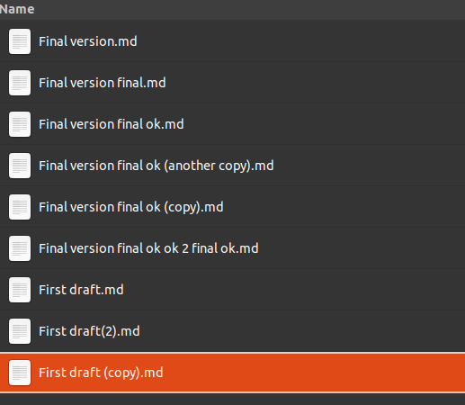
Why should you use version control:

Slide 6
Version control:
It helps in controlling the flow of information, the status of projects and log the different stages of work.
It also helps sharing code between teammates and maintain a project’s code base.

Slide 7
Git & GitHub

Slide 8
Notes:
to place the photograph select Change Background --> Choose Image --> from Drive --> shared drives --> Ironhack Design Database

Slide 9
They are not the same!
Notes:
to place the photograph select Change Background --> Choose Image --> from Drive --> shared drives --> Ironhack Design Database

Slide 11
Git:
Version control of your project in your local machine.
Git takes a snapshot of your project and keeps a copy of that state.
You can keep track of changes and versions of your work in the project, revert to a previous version or merge different files

Slide 12
Most often used Git commands:
git init -> this activates git in the folder you choose
git status -> checks if there are modified files in the project
git add . -> includes all the modified files into the next commit
git commit -m “some message” -> creates a new snapshot of your project and saves the latest changes you added.
git log -> shows in terminal a list of all commits in a project

Slide 13
Git flow example:
Version control system in a local machine
Initial commit Work on HTML Work on CSS Fix on UI Final version

Slide 14
How often should I commit?
There is no rule of thumb on when you should make a new commit, but try to do it as often as you can.
During project weeks, commit often, specially whenever you are done working on a feature and you have not begun working on the next one.

Slide 15
How to write commit messages?
A good Git commit message is the best way to explain a change to other developers and to your future self.
Write your commit message in imperative: git commit -m "Fix X to allow Y to use Z".
Short (50/70 characters or less)
Specify vital info

Slide 17
GitHub:
Version control of your project in an online repository.
It allows you to share code and collaborate with other developers.
You can store and recover your projects if your local machine fails or stops working.
It allows the teaching team to see your work.

Slide 18
Most often used GitHub commands:
fork -> the action of copying someone’s repo into your account
git clone -> downloads a version of the project into your computer
git pull -> the action of updating a previously downloaded repository
git push -> the action of uploading new changes to the project into the GitHub online repository

Slide 19
How do Git and GitHub
work together?
Notes:
to place the photograph select Change Background --> Choose Image --> from Drive --> shared drives --> Ironhack Design Database

Slide 20
Version control system in a local machine
Initial commit version 0.2 Bug fix version 0.9 Final version
Initial commit Git push Final version
Version control system in a cloud server

Slide 21
How to use Git and GitHub
for the Labs
Notes:
to place the photograph select Change Background --> Choose Image --> from Drive --> shared drives --> Ironhack Design Database

Slide 22
The 6 steps to succeed during labs
Fork
Clone
Work
Commit
Push
Share link

Slide 23
Detailed step by step instructions
Open the lab link from the student platform.
Log in to GitHub.
Fork the repository.
Once in our repo, click the green box “code” and copy the link.
Go to your terminal and navigate to the folder where you store your labs.
Type “git clone” and paste the link afterwards.
Navigate inside the new folder.
Edit files or create new files as specified in the lab.
Add the modified files with “git add .”
Then use “git commit -m ‘lab complete’”
Use “git push”
Copy and paste the link to the directory for the lab into the student platform
Have some rest and get ready for tomorrow!

Slide 24
Extra resources:
What’s a DVSC anyway?
Commit naming convention tips

